Slide 1
Exploring roles through offline role-play
Understanding, Preventing, Responding
Ages 11-13, Ages 14-18

Slide 2
Exploring roles through offline role-play
Timing: 35-40 minutes (+ additional time for setting expectations)
Learning outcomes:
Learners will be able to:
Recognise and understand the roles that can exist in a cyberbullying situation.
Identify positive strategies for managing and responding to cyberbullying in different contexts.
Key vocabulary: cyberbullying, roles, instigator, bystander, target, cheerleader, stirrer, admirer, follower, joker, context, strategies.
Resources:Cyberbullying scenarios (slides 7-8), Role cards (slide 9), Child Protection Guidance.

Slide 3
Key Questions
What are the different roles that can exist in a cyberbullying situation?
How would you define/explain these roles?
How can different roles influence the behaviour of…
...a cyberbully?
...a target?
...a bystander?
What contexts might also affect behaviour? (e.g. If you saw one friend bullying another friend, would this be easier/harder to tackle than if they were strangers to you?)
What strategies could you use to positively affect the situation if you were…
...a cyberbully?
…a target?
...a bystander?
...a follower/admirer/cheerleader?
What strategies/tools could you use to seek with bullying?

Slide 4
We all have a role
Think about the different roles in cyberbullying.
How many different roles can you think of?
How would you define or explain those roles?

Slide 5
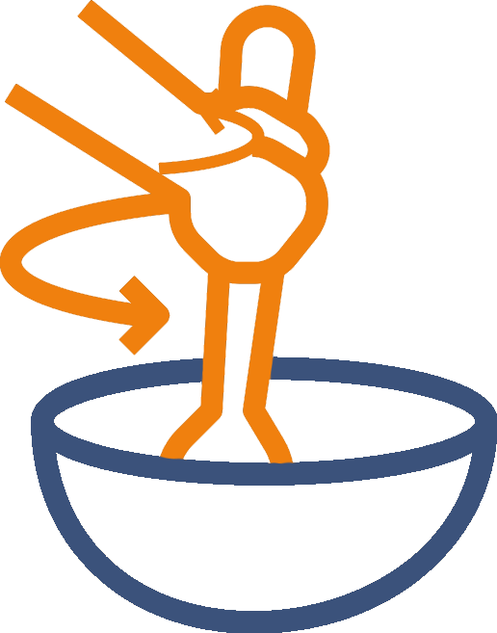
How would you define these roles?
Cheerleader
Stirrer
Admirer
Follower
Joker
Cyberbully
Target of bullying
Bystander
Upstander (someone who stands up to the bully)

Slide 6
Bullying scenarios
We will be exploring a cyberbullying scenario and adopting a role.
All the communication will take place face-to-face.
What do we need to agree before we begin?

Slide 7
Scenarios
There is a new member of your youth group. They are quite shy and haven’t revealed much about themselves. One of your friends starts to pick on them online for being different...
You have joined an online chat group to discuss your favourite music. Although you don’t know anyone there, it is clear that a member of the group is being targeted because of their religious views...
A young person has recently told everyone in school that they belong to the LGBTQ+ community. Someone in their class starts to say homophobic comments towards them online...
There is a young person who lives close to you and enjoys sharing lots of photos and details about their life on social media. Someone keeps posting mean comments under their photos...

Slide 8
Scenarios
The leader of your online gaming group has recently started using sexist language and has threatened to kick out a female member of the group because ‘she isn’t good enough’....
Your best friend recently broke up with their partner. They feel upset and have started posting revealing pictures of their ex-partner to get revenge on them...
A member of your family has started responding to a politician’s tweets with unkind and threatening language. You don’t agree with the politician’s views, but...
You are fed up of the popular student at school always getting all the attention. So you set up a fake social media profile to make them look bad, and share the details in your school group chat...

Slide 9
Role cards
Cyberbully
Upstander
Admirer
Target
Cheerleader
Follower
Bystander
Stirrer
Joker

Slide 10
Debrief
How did you feel throughout the scenario?
Did your emotions change at any stage? How/why?
Did you identify any barriers to doing something or saying something?
If you replayed the scenario, what would you have done differently in your role?
Were there particular actions/words that made the situation worse? Why?
What actions/words could have helped the situation?

Slide 11
Comparison with online
Was tackling the situation face-to-face easier/harder? Why?
Was it easier to determine the emotions of others in the scenario? Did this make things better or worse?
How would you apply online strategies such as block, mute and report, and apply them to a face-to-face situation?

